Slide 1
Website, Revamped
Unit 15: Web Development
Unit 41: Advanced Web & App Development Studies
By – Viduth Tennakoon
iAMDT1734

Slide 2
Acknowledgment
I hereby would like to thank, AMDT and lectures for the resources and teaching the required skills and assisting me. My parents for providing me with necessary resources. My friends colleges for the support to make this project a success…

Slide 3
Content
Wireframes
Usability Principles (JAKOB NIELSEN’S USABILITY PRINCIPLES)
Final outcome of the web pages
User Acceptance Testing

Slide 4
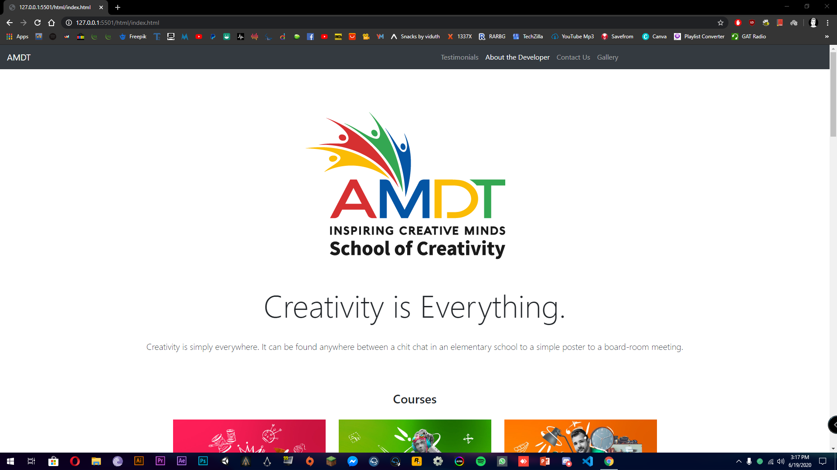
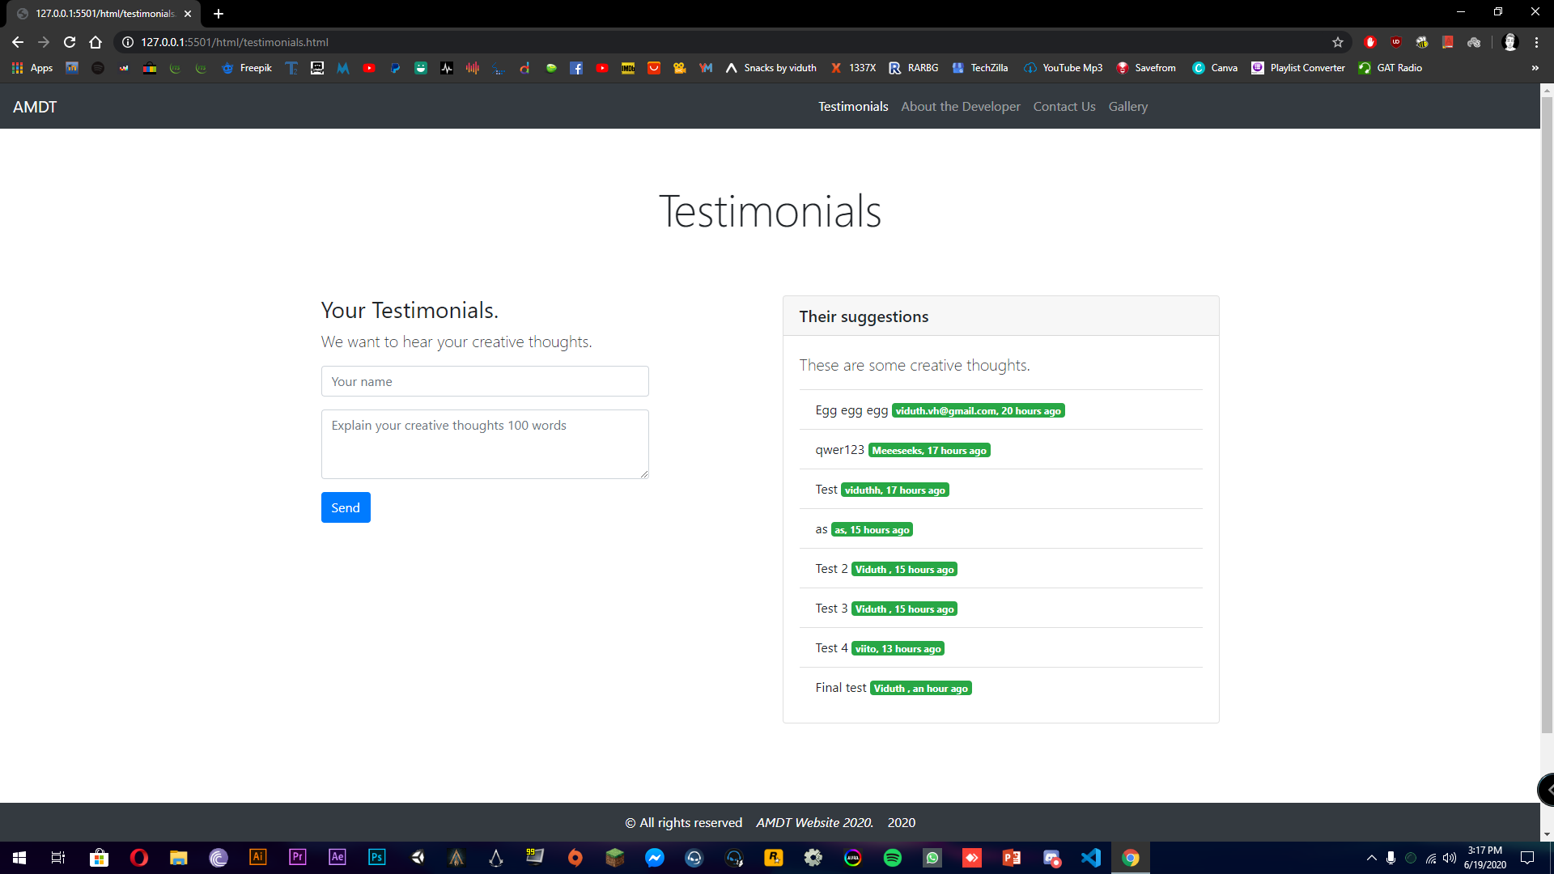
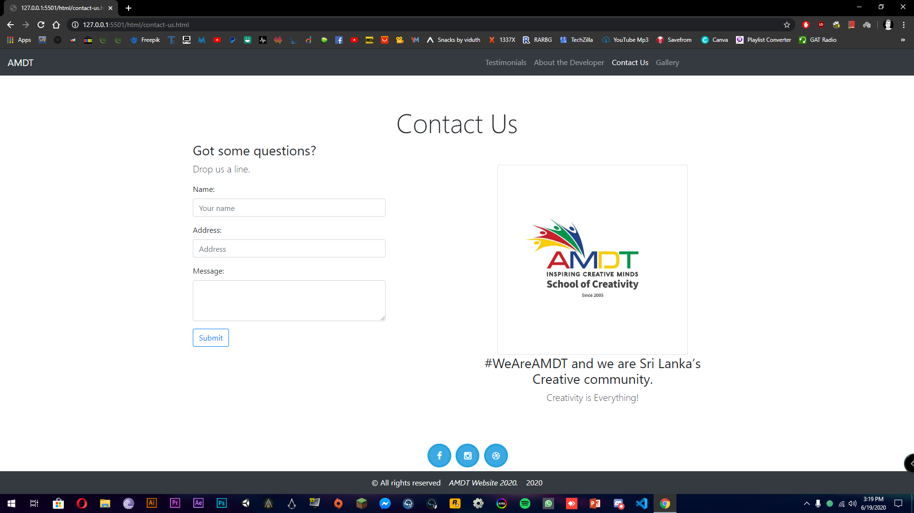
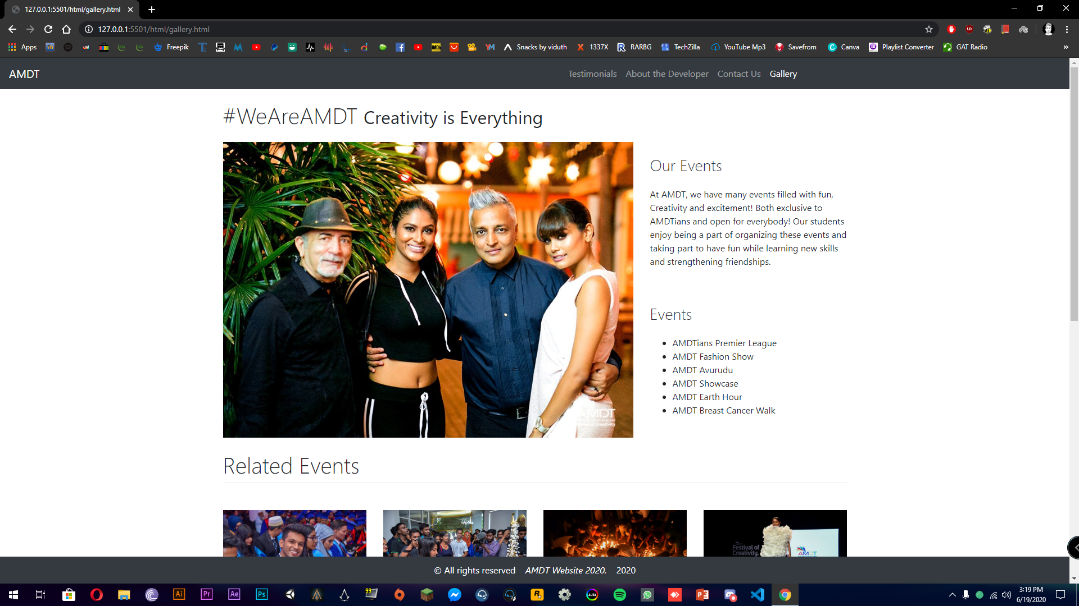
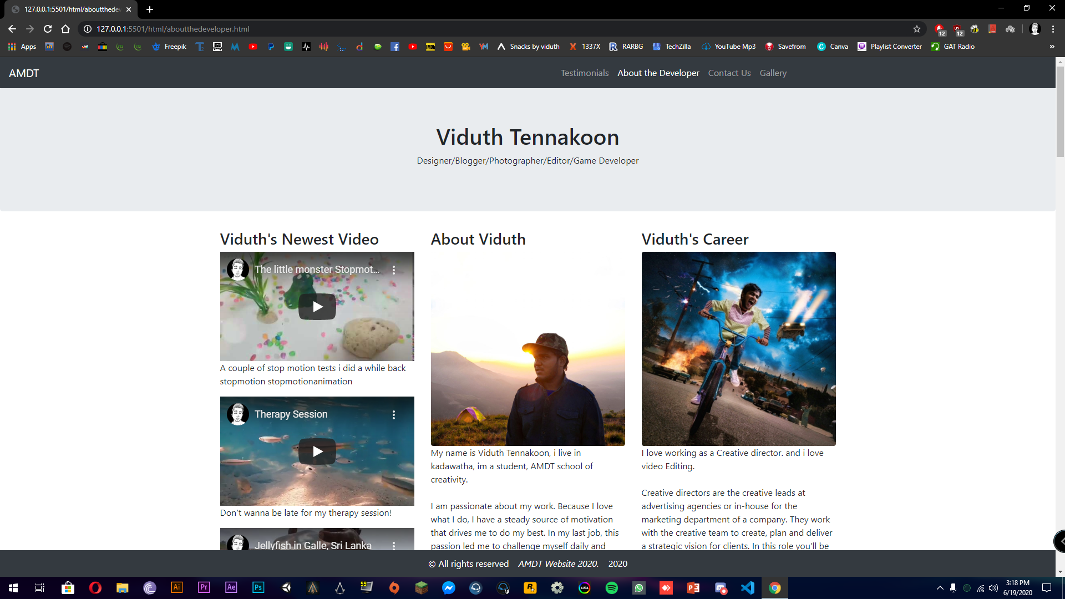
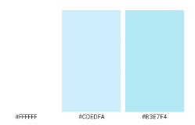
Little bit about the website
I have used a light color theme on the website. (White, blue and Gray colors)
A simple way of presenting the things needed to be seen on the site.
Through out the site I have try to show its minimalist design.

Slide 5
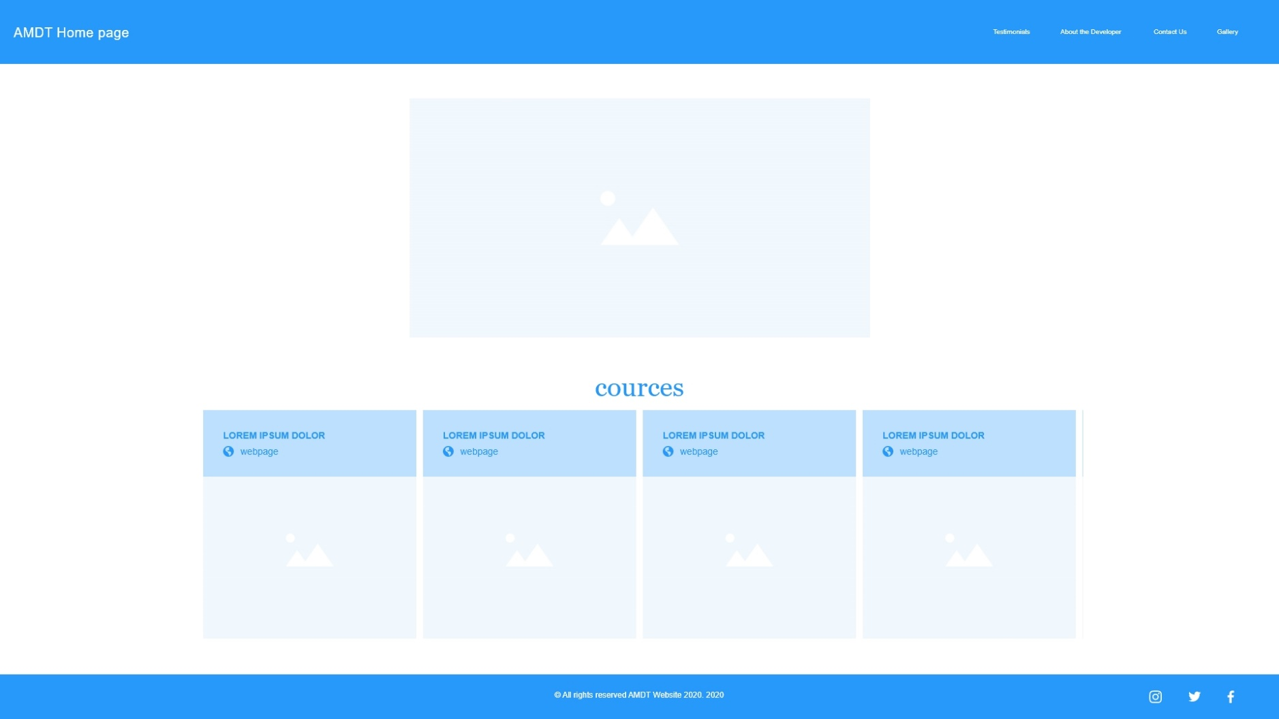
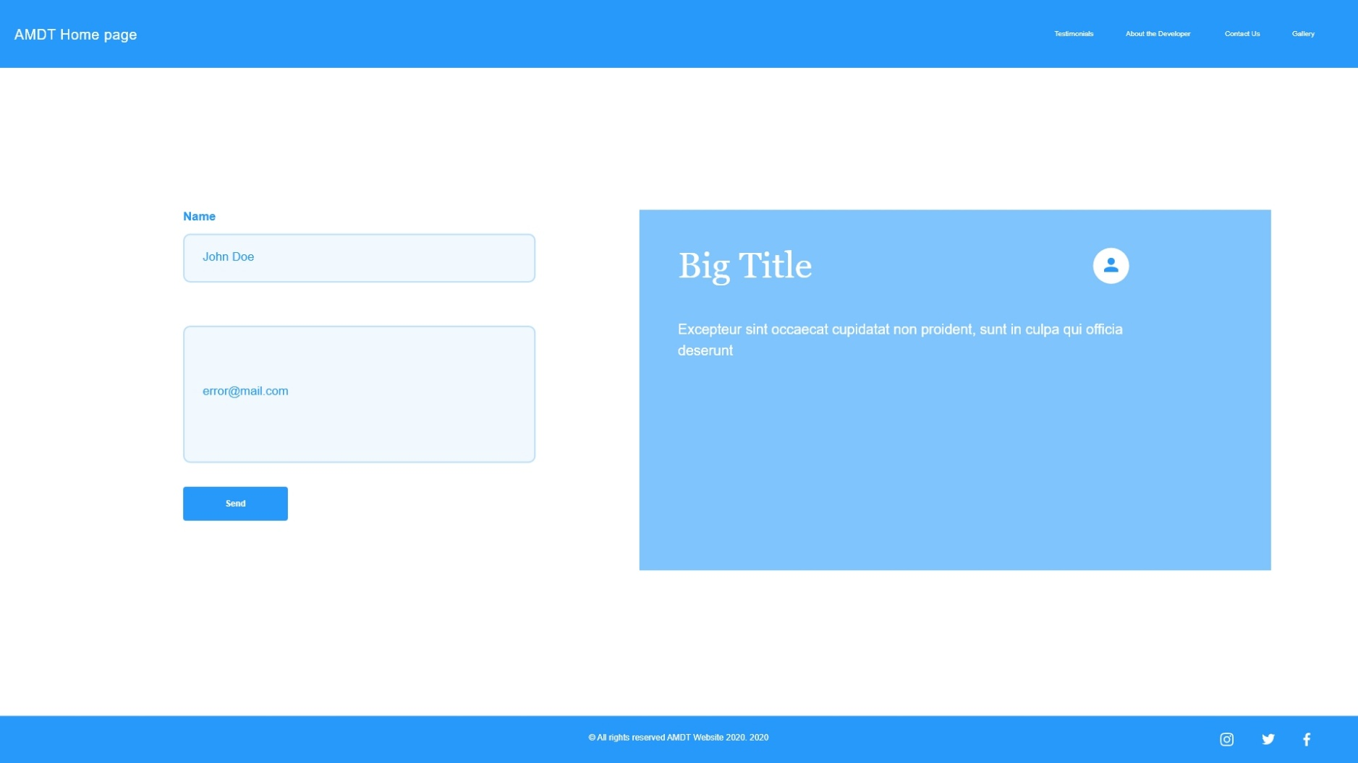
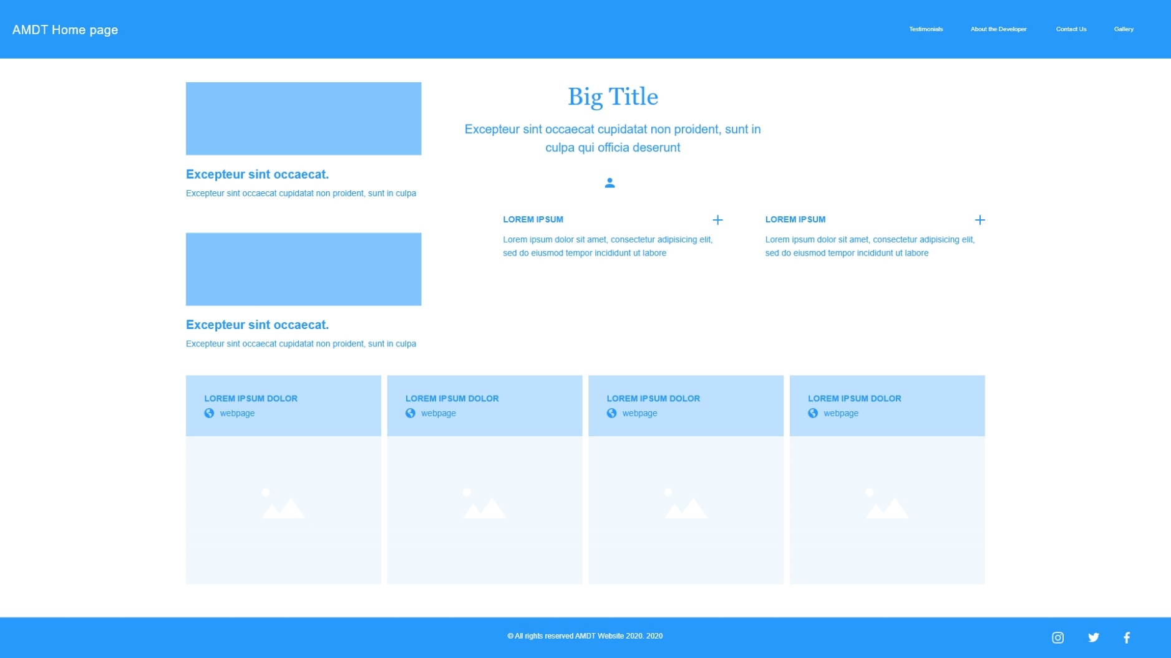
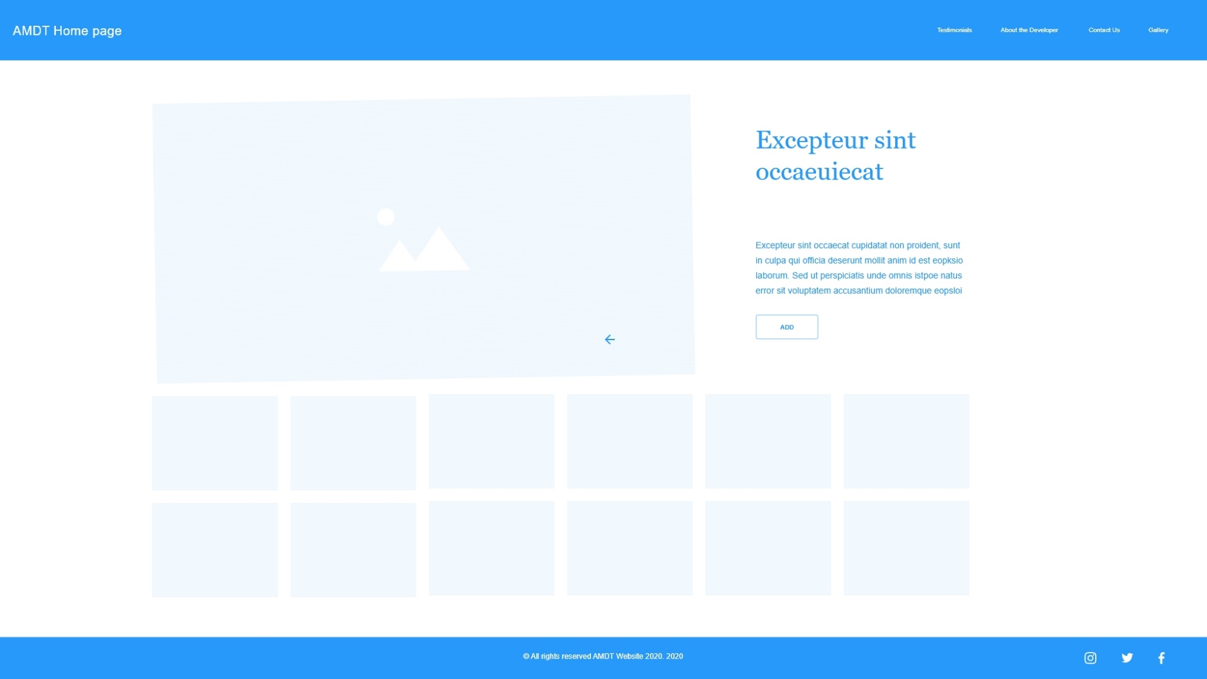
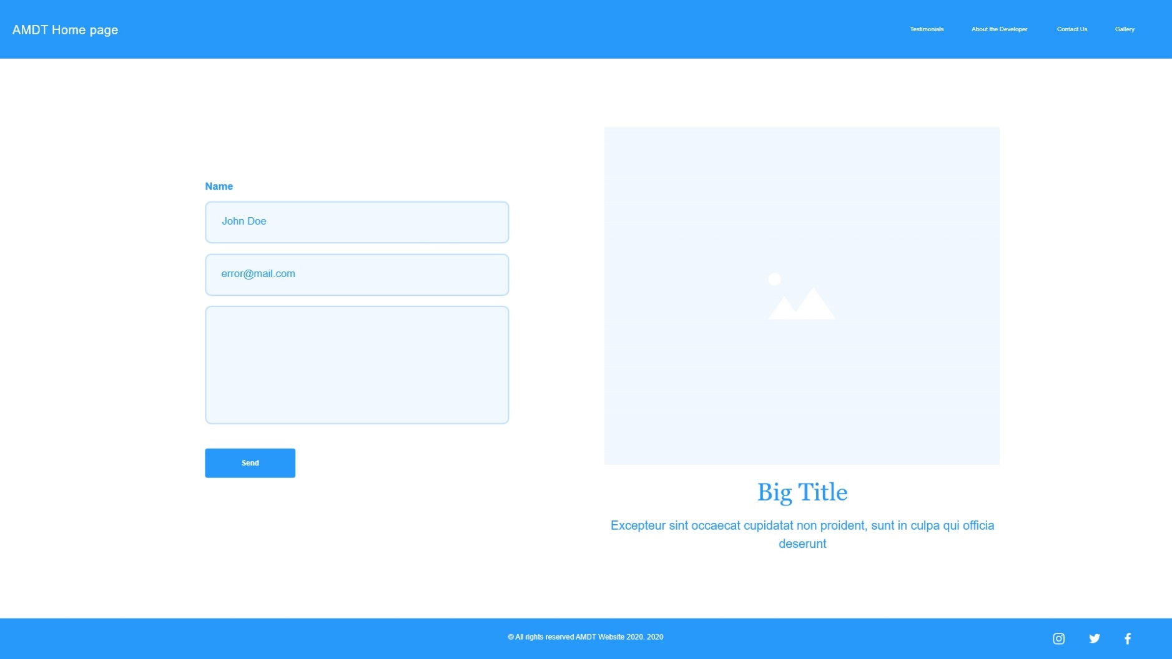
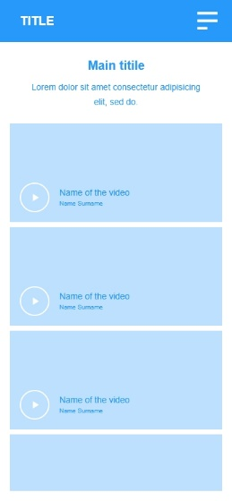
WIREFRAMES
1st page
2nd page
3rd page
4th page
5th page
3rd page mobile view

Slide 6
Home page (landing page)
I will make a simple home page to show the minimalist design on it .
Homepage includes the set of coerces and extra details on the campus plus upcoming events list

Slide 7
Testimonials
2nd page which is testimonials, its also a simple page that you can give your thoughts by typing In the boxes and it will be displayed on the right side box as a list with time u set it.

Slide 8
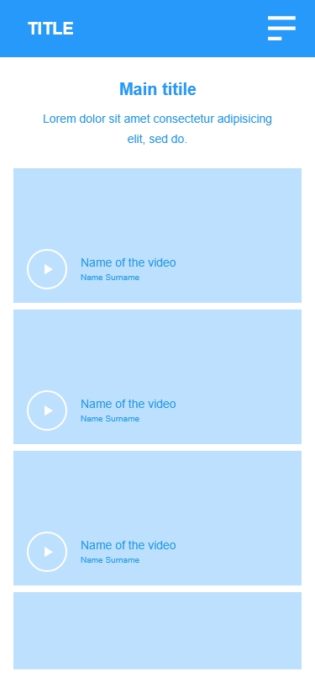
About the developer
3rd page is about myself and my work.
I will use my pics and videos on image boxes and descriptions to get a nice looking portfolio.
This page is also responsive on mobile devices for that I will use CSS Media queries

Slide 9
Contact us
4th page is contact us page which any person can contact the amdt through a email
I will use txt boxes and buttons. And will keep this page as simple as it is.

Slide 10
Gallery
Final page will be gallery, I'm going to ass some of the best pictures captured from the college and add here in a nice manner and will be able to check on the albums that I will hyper link them to the amdt official website

Slide 11
Usability Principles that I have used from “JAKOB NIELSEN’S USABILITY PRINCIPLES”

Slide 12
Visibility of system status
The Website always keeps users informed about what is going on through feedbacks within short time.
The visibility of system status alludes to how well the condition of the system is passed on to its clients. Preferably, systems ought to consistently keep clients educated about what is happening, through fitting criticism inside sensible time.

Slide 13
User control and freedom
Clients often pick system works accidentally and will require an unmistakably checked "crisis exit" to leave the undesirable state without experiencing an all-encompassing exchange. Backing fix and re-try.
If ever come up with a problem clicking on AMDT logo on navigation bar will put you back to the homepage.

Slide 14
Aesthetic and minimalist design
Exchanges ought not contain data which is unessential or once in a while required. Each additional unit of data in an exchange rivals the important units of data and decreases their relative visibility.

Slide 15
Match between system and the real world
The system ought to communicate in the clients' language, with words, expressions and ideas natural to the client, instead of system-situated terms. Follow genuine shows, causing data to show up in a characteristic and consistent request.

Slide 16
Recognition rather than recall
Limit the client's memory load by making items, activities, and choices noticeable. The client ought not need to recollect data starting with one piece of the discourse then onto the next. Guidelines for utilization of the system ought to be noticeable or effectively retrievable at whatever point suitable.

Slide 17
Final outcome of the web pages

Slide 18
Home page (landing page)
This is my landing page. I have add the coerces and relevant posts with some details to show a clean page to the viewer at the 1st page
I have used hover effects on coerces to give a better feel.

Slide 19
Testimonials
This is my testimonial page. I kept it simple so anyone can add there suggestions and see it on the right side box
To this I have used database with MongoDb.
So it displays the details with time and relevant message

Slide 20
About the developer
This is my portfolio page that I included my details plus work I've done, videos I created.
I used html and css to make a nice page to the about the developer

Slide 21
Contact us
This is my contact us page. This also I kept simple to make the viewer feel the minimalism.
I have used mailer.js to send email on the contact us page
So anyone can contact Amdt through their email, and that email will be send to our email.

Slide 22
Gallery
This is my last page I have used a extra page as the gallery I have included some of the albums and events in Amdt and linked them in to the official website albums.
Also I used the upcoming event with hover styles to this page.

Slide 23
User Acceptance Testing

Slide 24
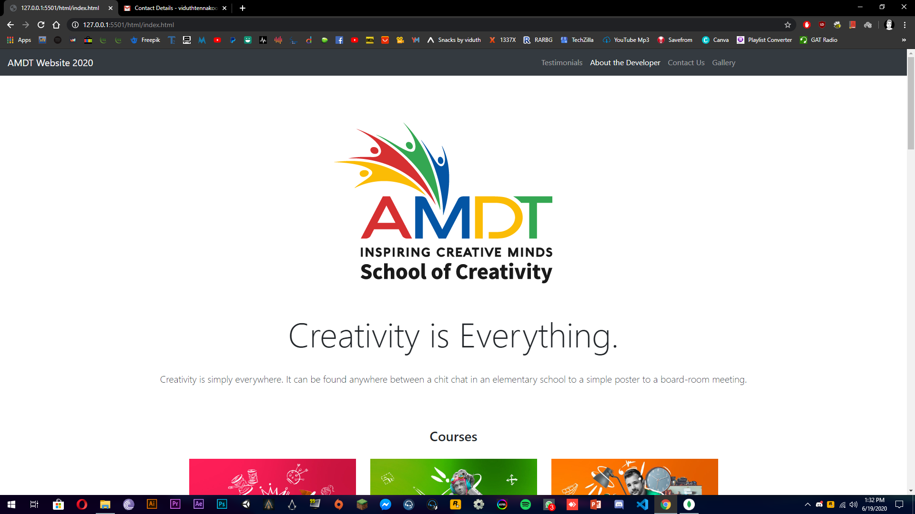
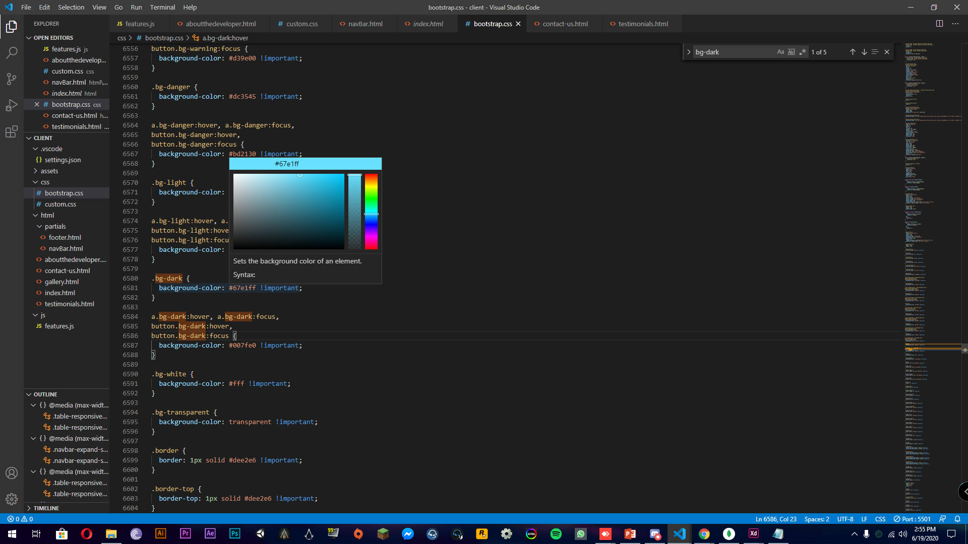
User acceptance testing that I did
My cousin said that the Navigation bar is too dark so I had to change it to a light blue color because it looked good on it.
Color change
I changed the colour in to blue

Slide 25
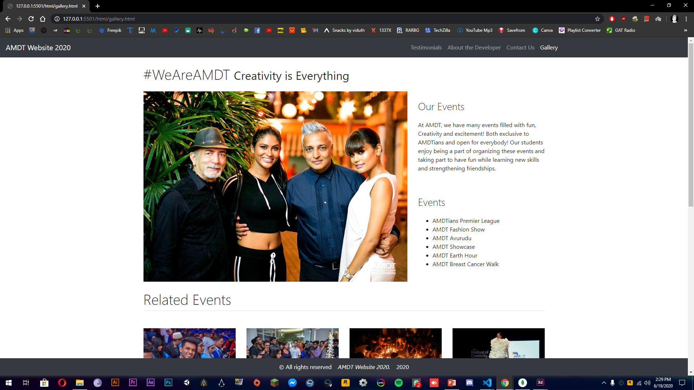
User acceptance testing that I did
Home button was as a text “Amdt Website 2020” I had to changed it in to the Amdt logo instead because it looked more professional.
Changed to the logo

Slide 26
Reference
Nielsen Norman Group. 2020. 10 Heuristics For User Interface Design: Article By Jakob Nielsen. [online] Available at: <https://www.nngroup.com/articles/ten-usability-heuristics/> [Accessed 16 June 2020].

Slide 27
Thank You!

